Slide 1

FEATURE 1
Electronic Signature
& Intake Gateway
A touch-and-mouse signature pad that captures a client's authorization and embeds it into an official, exportable PDF quotation.
Project CP-004 · Klass Dignity Care Portal
Notes:
Feature 1 of 4: the E-Signature & Intake Gateway. This is the final step of the customer journey — after the family has chosen their package, they authorize it by signing on-screen, and we generate an official PDF quote.

Slide 2
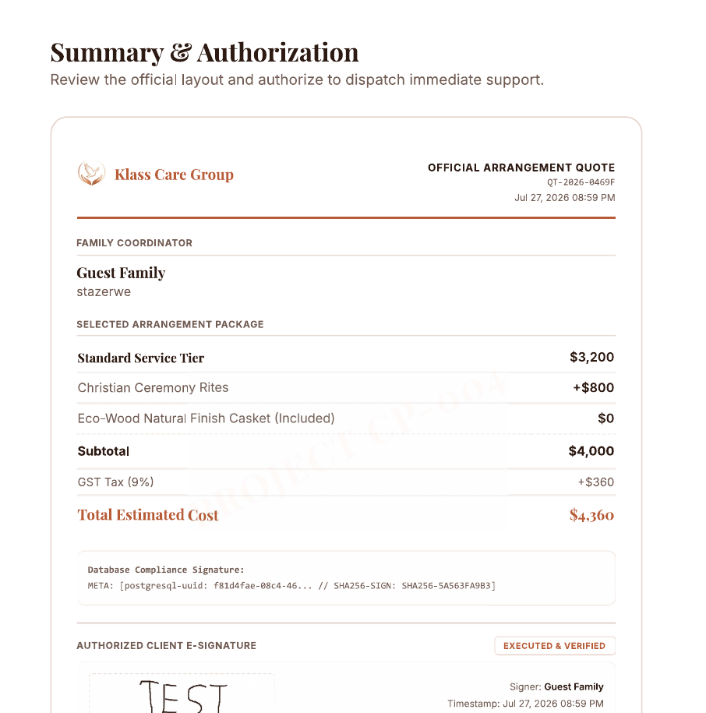
What the feature does
1
Capture
The client signs directly on-screen with a finger, stylus, or mouse — no printing, no scanning.
2
Embed
The signature is placed into the official itemized quotation alongside a timestamp and signer name.
3
Export
The signed quote is exported as a clean, professional PDF the family can keep or forward.
Klass Dignity Care · E-Signature & Intake Gateway
2
Notes:
Three things at a high level: Capture the signature, Embed it into the quote, Export to PDF. The card on the right is a real signed quote our system produced — not a mock-up.

Slide 3
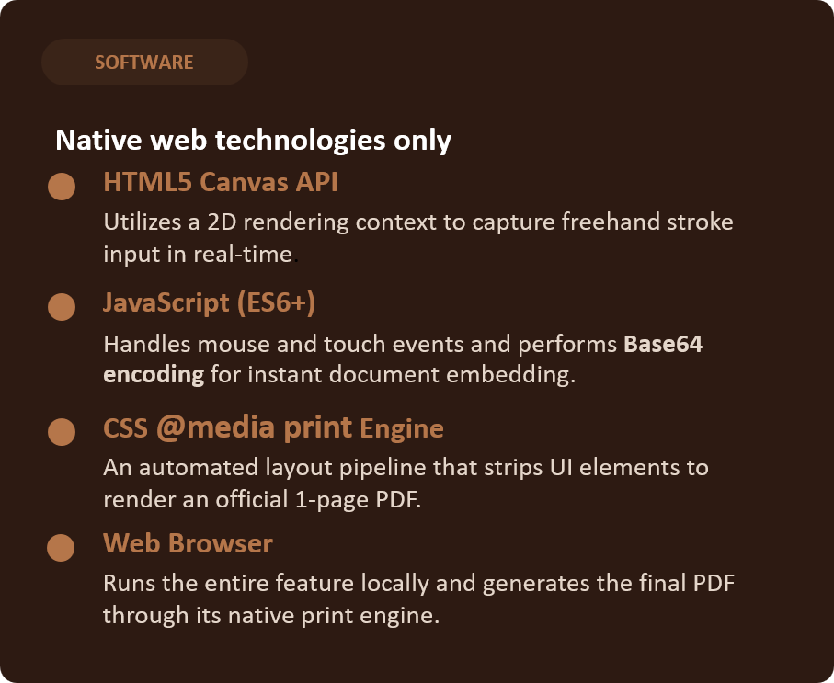
Requirements
HARDWARE
Touch-enabled client device
PC / Laptop
Signs with a mouse and trackpad
More to come…. (iPad, smartphones)
Klass Dignity Care · E-Signature & Intake Gateway
3
Notes:
Our requirements, side by side. HARDWARE: any touch-enabled client device — a tablet or phone with finger or stylus, or a PC with a mouse. Nothing special to buy. SOFTWARE: three native web technologies — HTML5 Canvas as the drawing surface, JavaScript to capture and place the signature, and the Web Browser to run it and produce the PDF. No external libraries or paid services, which fits our 'keep it simple, runs locally' project constraint.

Slide 4
How it works — the signature pipeline
From the client's finger on the screen to a finished, executed PDF quote.
User
Drawing
HTML5
Canvas
Base64
Conversion
syncPDF
Signature()
Browser Print
Engine
Final Executed
Quote
▶
▶
▶
▶
▶
finger / stylus
or mouse
strokes drawn
live
canvas to PNG
data URL
injects into
the quote
print CSS
isolates quote
signed PDF
output
What happens at each stage
1 User Drawing
2 HTML5 Canvas
mousedown / mousemove and touchstart / touchmove listeners fire as the client signs.
ctx.lineTo() and ctx.stroke() draw each stroke onto the canvas in real time.
3 Base64 Conversion
4 syncPDFSignature()
canvas.toDataURL() converts the drawing into a PNG image string (a data URL).
Saves it to state, sets the quote image source, and flips status to EXECUTED & VERIFIED.
5 Browser Print Engine
6 Final Executed Quote
window.print() runs; the print stylesheet hides the app and shows only the quote.
A clean one-page PDF with the signature, signer name, timestamp and totals.
Klass Dignity Care · E-Signature & Intake Gateway
4
Notes:
This is the technical flow, left to right. The User Drawing fires mouse and touch events. The HTML5 Canvas renders each stroke live using lineTo and stroke. Then canvas.toDataURL performs the Base64 Conversion, turning the drawing into a PNG data URL. Our syncPDFSignature function takes that string, saves it into the app state, sets it as the image inside the quote, and flips the status to EXECUTED & VERIFIED. Finally window.print triggers the Browser Print Engine, and our print stylesheet hides the app interface so only the quote renders — producing the Final Executed Quote as a PDF. Worth noting: syncPDFSignature is a JavaScript function in our own code, not an external API call — everything here runs client-side in the browser.

Slide 5
The result
✓ EXECUTED & VERIFIED
A signed, timestamped, itemized quote — exported to PDF in one click.
Scope (Proof of Concept)
•
Captures a real drawn signature (touch + mouse).
•
Embeds it into the exportable PDF quote.
•
The “SHA-256” label marks where production-grade cryptographic signing would be added later.
Klass Dignity Care · E-Signature & Intake Gateway
6
Notes:
The result: a signed, timestamped, itemized quote exported in one click. Being honest about scope — this is a proof of concept: the signature capture and PDF embedding are fully real; the SHA-256 label marks where production cryptographic signing would be added in a real deployment. That's the boundary of our prototype.

